Slide 1
Clean architecture
CPE Tech Talk - 1st March 2021
Michal Konečný

Slide 2

Robert C. Martin
“Uncle Bob” Martin
Wikipedia

Slide 3

What is the Clean Architecture?

Slide 4
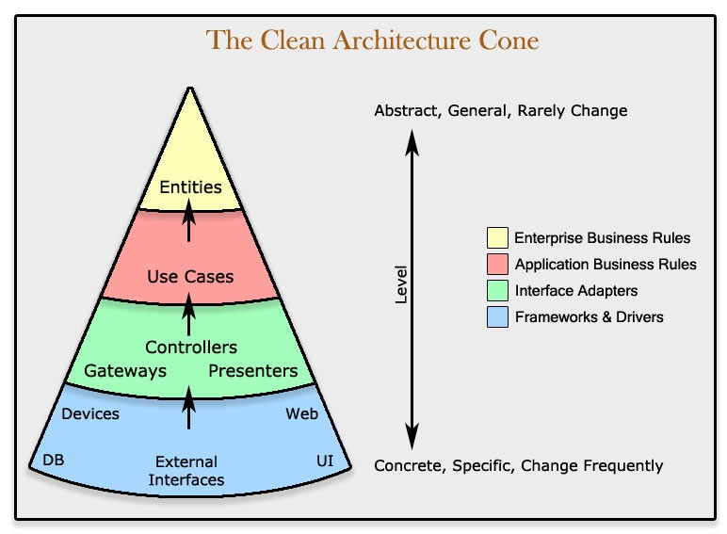
What is the Clean Architecture?

Slide 5
Clean Architecture in Python
Layer communication through Requests and Responses
Abstract Classes inherited by outer layers
No third party libraries except for external interfaces

Slide 6
Pros and Cons
Pros
Long term maintenance is easier
Interchangeability of external services
Customer oriented (use cases)
Modularity
Cons
Slower development
If the core design is changed, it’s more complicated to do the changes
Need to keep dependency injection in mind

Slide 7
References
A quick introduction to clean architecture
The Clean Architecture – The Clean Code blog
The-new-hotness – Clean Architecture design
Robert C. Martin - Wikipedia

